Slide 1
Dual fitting in online algorithms
Naveen Garg
IIT Delhi
Joint work with S. Anand, Syamantak Das, Anamitra Chowdhary
and Amit Kumar (IIT Delhi)

Slide 2
What is dual fitting?
A way to argue about the approximation/competitive ratio of an algorithm.
In many cases the algorithm is greedy.
A dual solution is built using the properties of the algorithm.
Has been successful for problems in facility location, online allocation and online scheduling.

Slide 3
Plan of the tutorial
Warmup- Analyse set cover (offline) using dual fitting
Dual fitting for online algorithms
Scheduling with speed augmentation
Scheduling with rejection.

Slide 4
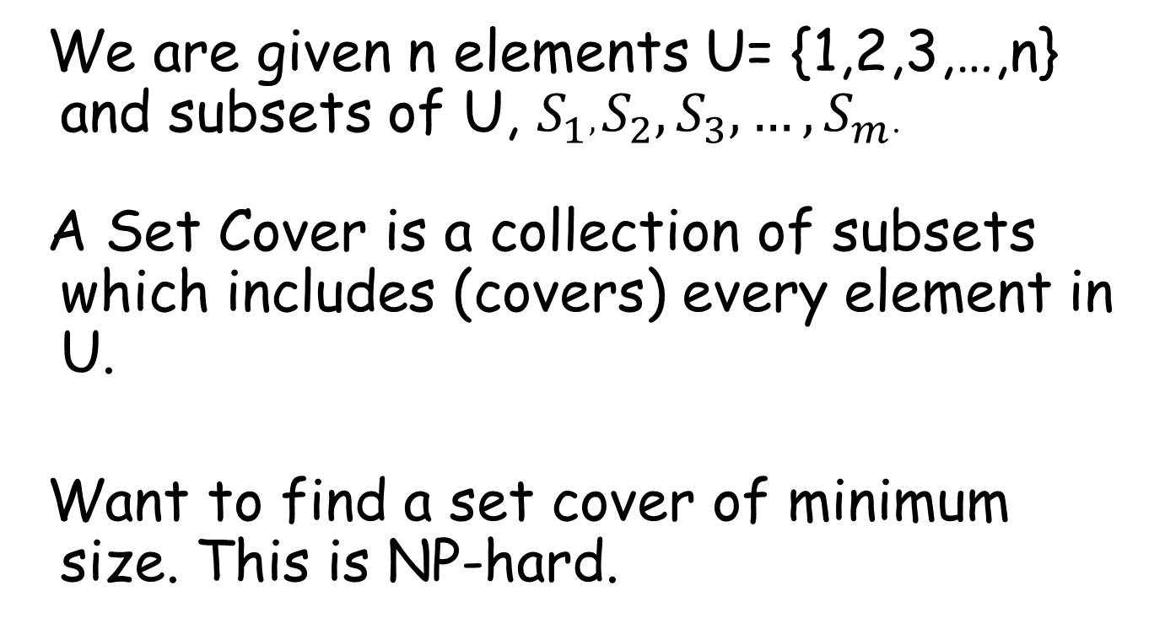
Set Cover
We are given n elements U= {1,2,3,…,n} and subsets of U, $S_{1}, S_{2}, S_{3},…, S_{m}$.
A Set Cover is a collection of subsets which includes (covers) every element in U.
Want to find a set cover of minimum size. This is NP-hard.

Slide 5
Greedy Algorithm
Pick the set which covers the most number of uncovered elements.
Repeat above step till all elements are covered.

Slide 6
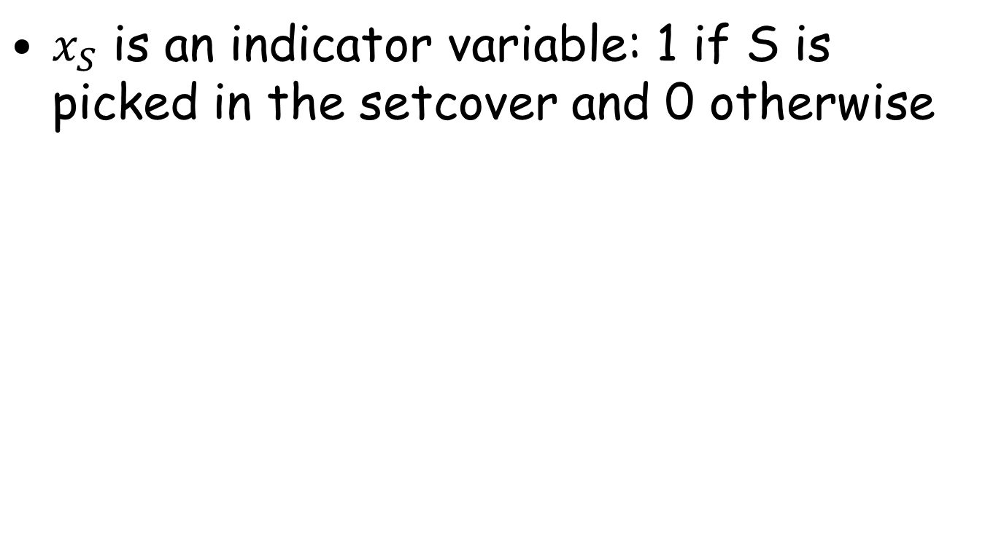
An Integer program for set cover
$x_{S}$ is an indicator variable: 1 if S is picked in the setcover and 0 otherwise
Every element e should be included in at least one set.

Slide 7
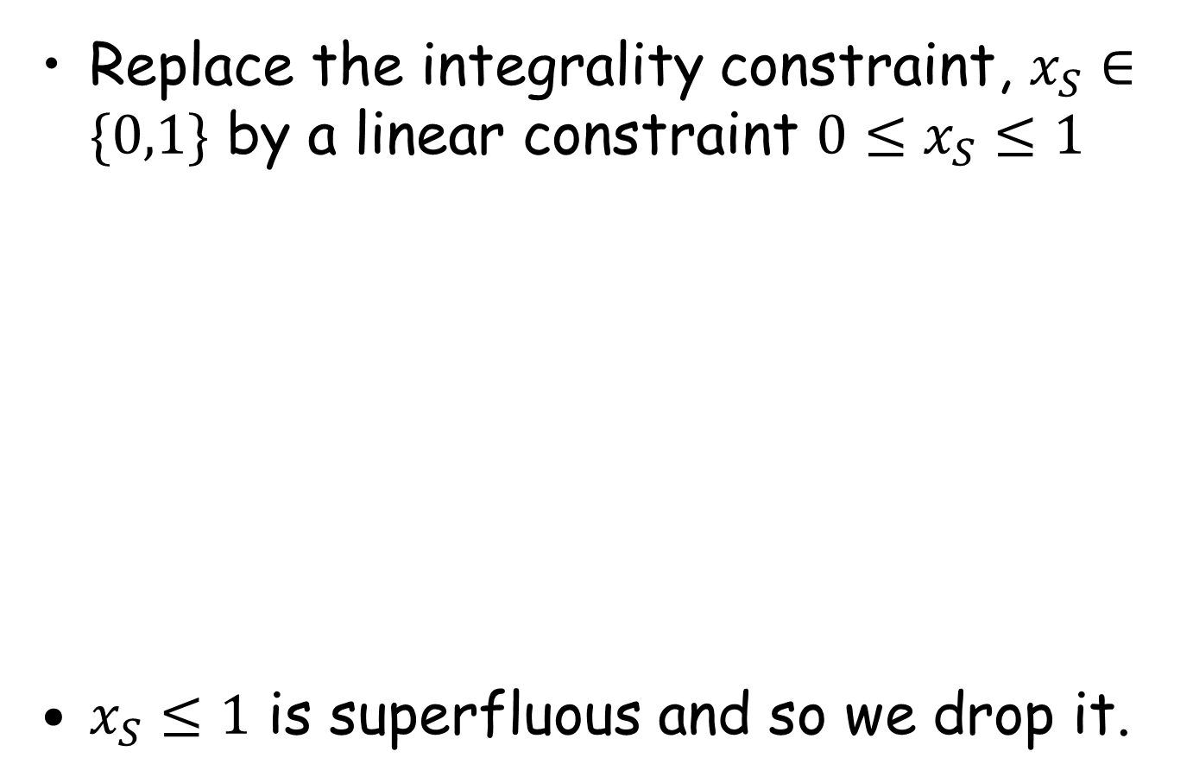
A LP-relaxation for set cover
Replace the integrality constraint, $x_{S}∈\{0,1\}$ by a linear constraint $0≤x_{S}≤1$
$x_{S}≤1$ is superfluous and so we drop it.

Slide 8
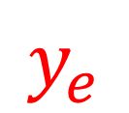
Primal and Dual LPs
$$y_{e}$$

Slide 9
Analyzing GREEDY
Approximation/ competitive ratio
Dual LP
Primal LP
GREEDY solution
Construct a dual
solution
LP opt. value
Show that the dual solution value and the no of sets picked by GREEDY are close to each other.
Notes:
Have a slide on related work, and a slide on our results.

Slide 10
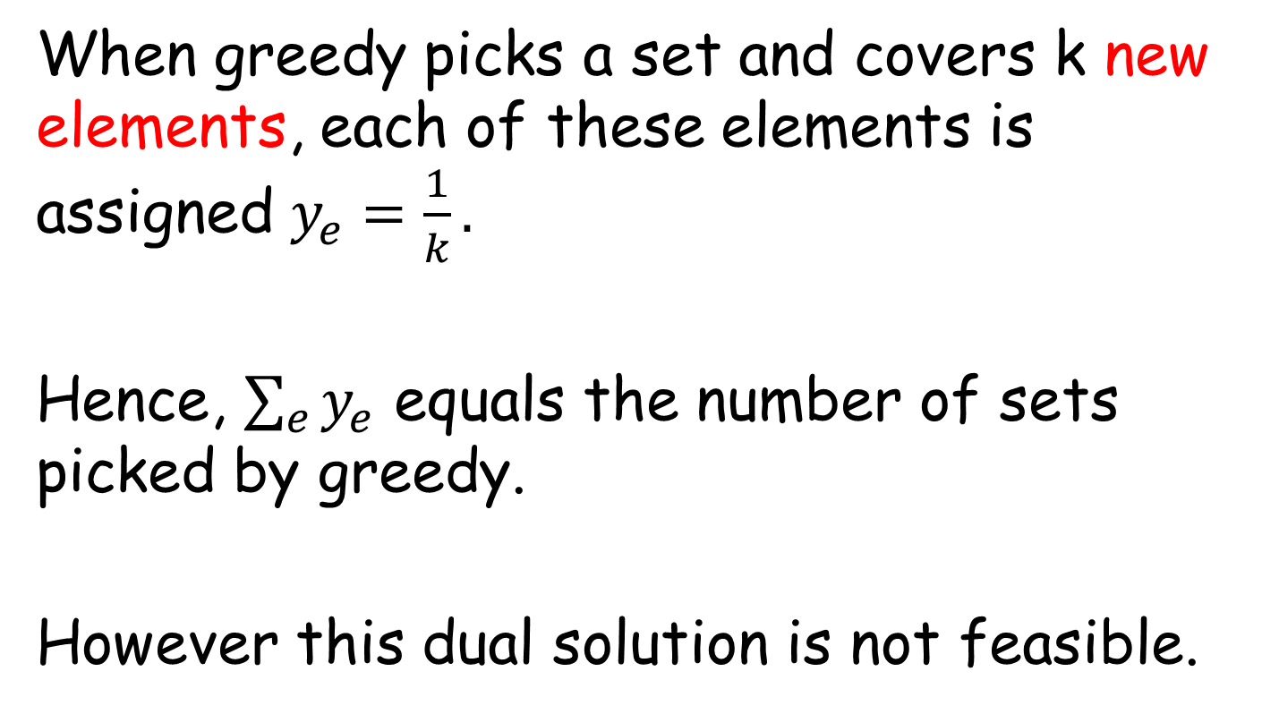
Building the dual solution
When greedy picks a set and covers k new elements, each of these elements is assigned $y_{e}=\frac{1}{k}.$
Hence, $\sum_{e}{y_{e}}$ equals the number of sets picked by greedy.
However this dual solution is not feasible.

Slide 11
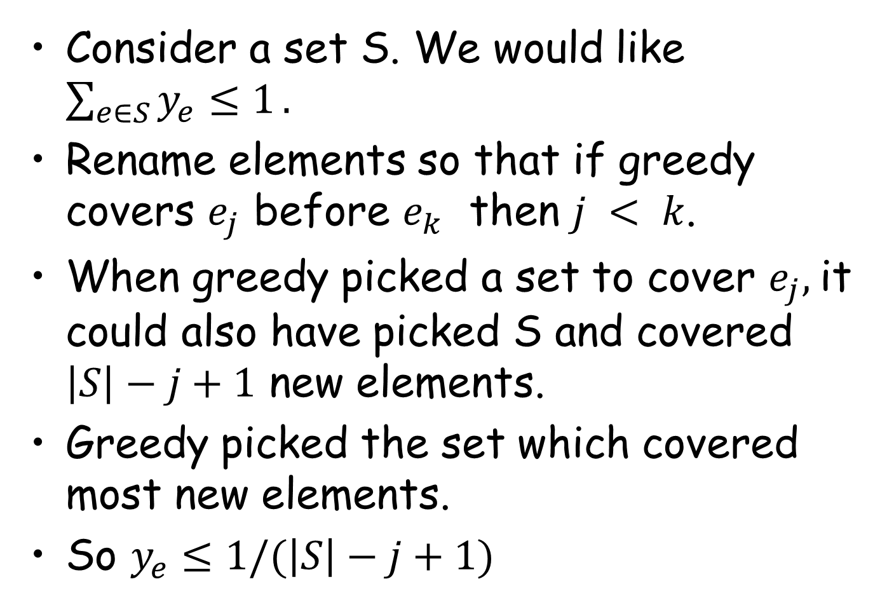
Making the dual feasible
Consider a set S. We would like $\sum_{e∈S}{y_{e}≤1}.$
Rename elements so that if greedy covers $e_{j}$ before $e_{k}$ then $j < k$.
When greedy picked a set to cover $e_{j},$it could also have picked S and covered $\left|S\right|−j+1$ new elements.
Greedy picked the set which covered most new elements.
So $y_{e}≤1/(\left|S\right|−j+1)$

Slide 12
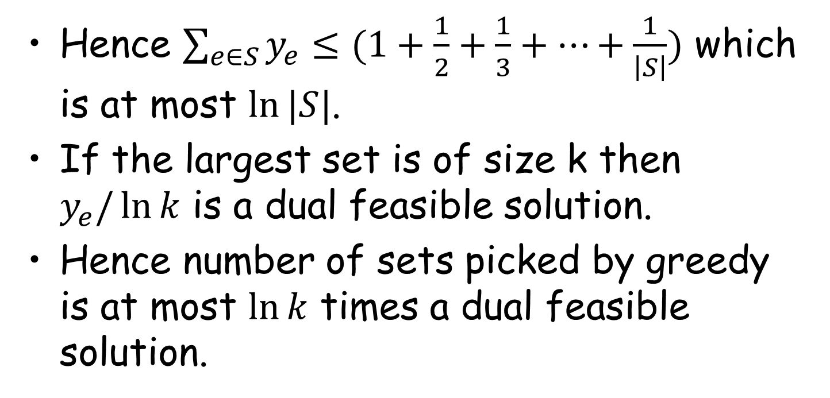
Analysis of Greedy
Hence $\sum_{e∈S}{y_{e}≤(1+\frac{1}{2}+\frac{1}{3}+…+\frac{1}{\left|S\right|})}$ which is at most $\ln{|S|}$.
If the largest set is of size k then $y_{e}/\ln{k}$ is a dual feasible solution.
Hence number of sets picked by greedy is at most $\ln{k}$ times a dual feasible solution.

Slide 13
Plan of the tutorial
Warmup- Analyse set cover (offline) using dual fitting
Dual fitting for online algorithms
Scheduling with speed augmentation
Scheduling with rejection.

Slide 14
Analysing online algorithms using Dual fitting
The Scheduling world is a rich source of problems for the online algorithms community
In this talk: show how to schedule jobs arriving online so that the average response time (flow time) is minimised.

Slide 15
Problem Definition
Given : A set of machines and a set of jobs. A matrix p_{ij} of processing times of
job i on machine j.
Each job j specifies a release date r_{j} and has weight w_{j}

Slide 16
Problem Definition
Pre-emption allowed
Migration not allowed

Slide 17
Problem Definition
Flow-time of j, F_{j} = C_{j} – r_{j}
Goal : Find a schedule which minimizes ∑_{j} w_{j} F_{j}

Slide 18
Problem Definition
Weighted flow-time =
∑_{t} total weight of jobs alive at time t

Slide 19
Special Cases
Parallel : all machines identical
Related : machines have different speeds
Subset Parallel : parallel except that a job can
only go on a subset of machines
Subset Related
All of these are NP-hard (even in un-weighted case).

Slide 20
Off-line versus On-line
Off-line : given the input (set of jobs with their
processing time, weight, release date).
On-line : know about a job only after it’s release date

Slide 21
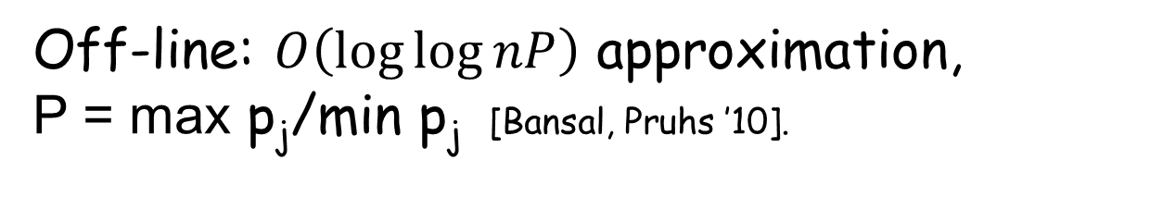
Single Machine
Unweighted Case :
SRPT : At each time, schedule the job with the
smallest remaining processing time.
SRPT is optimal, and on-line
Weighted Case :
No constant factor approx. known.
On-line: super constant lower bound
for deterministic algorithms [Bansal, Chan ’09].
Off-line: $O\left(\log{\log{nP}}\right)$ approximation,
P = max p_{j}/min p_{j} [Bansal, Pruhs ’10].

Slide 22
Parallel Machines
Unweighted Case :
O(log P)-competitive algorithm. [Leonardi, Raz ’97, …]
Almost matching lower bounds.
[Leonardi Raz ’97, GK. ’07]
Weighted Case :
No logarithmic approx. algorithms known.
Strong lower bounds for on-line case

Slide 23
unweighted Flow time
 | Online | Offline
Parallel machines | O(log P), Ω(log P) [LR ’97] | Ω(log^{1-ε} P) [GK ’07]
Related machines | O(log P) [AGK]
Subset parallel | Unbounded [GK ’07] | O(log P) [GK ’07] Ω(log P/loglogP)
Unrelated machines |  | O(min(log²n, lognlogP)) [BK ’14]

Slide 24
A bad example
B x
A+B=T
A> T/2
A x
A x
0
T
T+L
Flow time is at least AxL > T L/2
OPT flow time is O(T²+L)
Ω(T) lower bound on any online algorithm

Slide 25
Other Models
What if we allow the algorithm extra resources ?
In particular, suppose the algorithm can process (1+ε) units in 1 time-unit. [first proposed by Kalyanasundaram,Pruhs95]
Resource Augmentation Model
Notes:
Have a slide on related work, and a slide on our results.

Slide 26
Resource Augmentation
For a single machine, many natural scheduling algorithms are O(1/ε^{O(1)})-competitive with respect to any L_{p} norm [Bansal Pruhs ‘03]
Parallel machines : randomly assign each job to a machine – O(1/ε^{O(1)}) competitive
[Chekuri, Goel, Khanna, Kumar ’04]
Unrelated Machines : O(1/ε²)-competitive, even for weighted case. [Chadha, Garg, Kumar, Muralidhara ‘09]
Notes:
Have a slide on related work, and a slide on our results.

Slide 27
The plan for the next 30mins
An LP Formulation
Greedy algorithm for resource augmentation model for unrelated machines (all weights are 1)
Analysis by building a suitable dual
Extensions
Notes:
Have a slide on related work, and a slide on our results.

Slide 28
Fractional flow-time
Recall, flow-time of j =
p_{j}(t) = remaining processing of job j at time t
remaining fraction at time t =
Fractional flow-time of j = ∑_{t ¸ rj} p_{j}(t)/p_{ij}
Notes:
Have a slide on related work, and a slide on our results.

Slide 29
Fractional flow-time
0
1
2
5
12
Fractional flow-time = 1*2 + 2/3*3 + 1/3*7
Fractional flow-time can be much smaller than
(integral) flow-time
Notes:
Have a slide on related work, and a slide on our results.

Slide 30
Integer Program
Define 0-1 variables :
x(i,j,t) : 1 iff job j processed on i during [t,t+1]
Write constraints and objective in terms of these variables.
Fractional flow-time of j = ∑_{t ¸ rj} (t-r_{j}) ¢ x(i,j,t)/p_{ij}

Slide 31
LP Relaxation
One Caveat …

Slide 32
Fractional flow-time
A job can be done simultaneously on many machines : flow-time is almost 0
Notes:
Have a slide on related work, and a slide on our results.

Slide 33
LP Relaxation
Add a term for processing time

Slide 34
Our Algorithm
When a job arrives, we dispatch it to one of the
machines.
Each machine just follows the optimal policy :
Shortest Remaining Processing Time (SRPT)
What is the dispatch policy ?
GREEDY
Notes:
Have a slide on related work, and a slide on our results.

Slide 35
Our Algorithm
When a job j arrives, compute for each machine i
the increase in flow-time if we dispatch j to i.
j arrives at time t : p_{ij1}(t) · p_{ij2}(t) · …
p_{ijr}(t) < p_{ij} < p_{ijr+1}(t)
j₁
p_{j1}(t)
j₂
Increase in flow-time =
p_{j1}(t) + … + p_{jr}(t) + p_{ij}+ p_{ij}(s-r)
j_{r}
j
j_{r+1}
j_{s}
Notes:
Have a slide on related work, and a slide on our results.

Slide 36
Our Algorithm
When a job j arrives, compute for each machine i
the increase in flow-time if we dispatch j to i.
Dispatch j to the machine for which
increase in fractional flow-time is minimum.
Notes:
Have a slide on related work, and a slide on our results.

Slide 37
Analyzing our algorithm
Dual LP
Primal LP
Algorithm’s value
Construct a dual
solution
LP opt. value
Show that the dual solution value and algorithm’s
flow-time are close to each other.
Notes:
Have a slide on related work, and a slide on our results.

Slide 38
Dual LP
®_{j}
¯_{it}

Slide 39
Dual LP

Slide 40
Setting the Dual Values
When a job j arrives, set ®_{j} to the increase in flow-time when j is dispatched greedily.
j arrives at time t : p_{ij1}(t) · p_{ij2}(t) · …
j₁
p_{j1}(t)
p_{ijr}(t) < p_{ij} < p_{ijr+1}(t)
j₂
®_{j} = p_{j1}(t) + … + p_{jr}(t) + p_{ij} + p_{ij}(s-r)
j_{r}
Thus ∑_{j} α_{j} is equal to the total flow-time.
j_{r+1}
j_{s}
Notes:
Have a slide on related work, and a slide on our results.

Slide 41
Setting the Dual Values
Set ¯_{it} to be the number of jobs waiting at time t for machine i.
¯_{it} = s
j₁
p_{j1}(t)
j₂
Thus ∑_{i,t} ¯_{it} is equal to the total flow-time.
j_{r}
j_{r+1}
j_{s}
Notes:
Have a slide on related work, and a slide on our results.

Slide 42
Dual Feasibility
Fix a machine i’, a job j and time t’.
Suppose p_{i’jl}(t) < p_{i’j} < p_{i’jl+1}(t)
j₁
p_{j1}(t)
j₂
j_{l}
Need to verify
j_{l+1}
j_{s}
Notes:
Have a slide on related work, and a slide on our results.

Slide 43
Dual Feasibility
What happens when t’ = t ?
j₁
p_{j1}(t)
j₂
j_{l}
j_{l+1}
j_{s}
Notes:
Have a slide on related work, and a slide on our results.

Slide 44
Dual Feasibility
What happens when t’ = t + ¢?
Suppose at time t’ job j_{k} is being processed
Case 1: k ≤ l
j₁
¢
j₂
j_{l}
j_{l+1}
j_{s}
Notes:
Have a slide on related work, and a slide on our results.

Slide 45
Dual Feasibility
Case 2: k > l
¢
j₂
j_{r}
j_{r+1}
j_{s}
Notes:
Have a slide on related work, and a slide on our results.

Slide 46
Dual Feasibility
Hence, for any machine i’, time t’ and job j
So, ®_{j}, ¯_{it} are dual feasible
But ∑_{i,t} ¯_{it} and ∑_{j} α_{j} both equal the total flow time and hence the dual objective value is
Notes:
Have a slide on related work, and a slide on our results.

Slide 47
Incorporating machine speed-up
For any machine i’, time t’ and job j
So the values ®_{j}, ¯_{it}/(1+ε) are dual feasible for an
instance with processing times larger by a factor (1+ε)
Equivalently, schedule given instance on machines of
speed (1+ε) to determine ®_{j}, ¯_{it}. The values ®_{j}, ¯_{it}/(1+ε)
are dual feasible.
Notes:
Have a slide on related work, and a slide on our results.

Slide 48
Dual Objective Value
Since ∑_{i,t} ¯_{it} = ∑_{j} α_{j} the value of the dual is
The dual value is less than the optimum fractional flow time.
Hence, the flow time of our solution, ∑_{j} ®_{j}, is at most (1+1/ε) times the optimum fractional flow time.
Notes:
Have a slide on related work, and a slide on our results.

Slide 49
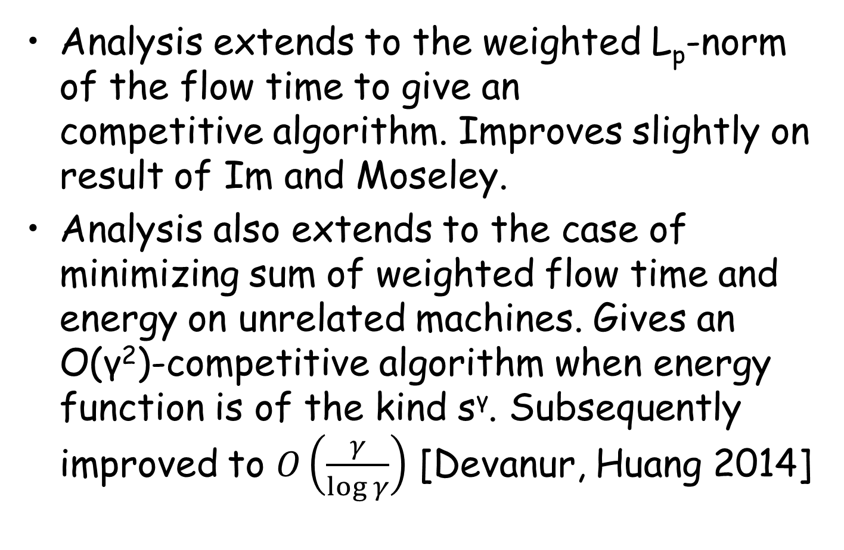
Extensions
Analysis extends to the weighted L_{p}-norm of the flow time to give an competitive algorithm. Improves slightly on result of Im and Moseley.
Analysis also extends to the case of minimizing sum of weighted flow time and energy on unrelated machines. Gives an O(γ²)-competitive algorithm when energy function is of the kind s^{γ}. Subsequently improved to $O\left(\frac{γ}{log γ}\right)$ [Devanur, Huang 2014]

Slide 50
Plan of the tutorial
Warmup- Analyse set cover (offline) using dual fitting
Dual fitting for online algorithms
Scheduling with speed augmentation
Scheduling with rejection.

Slide 51
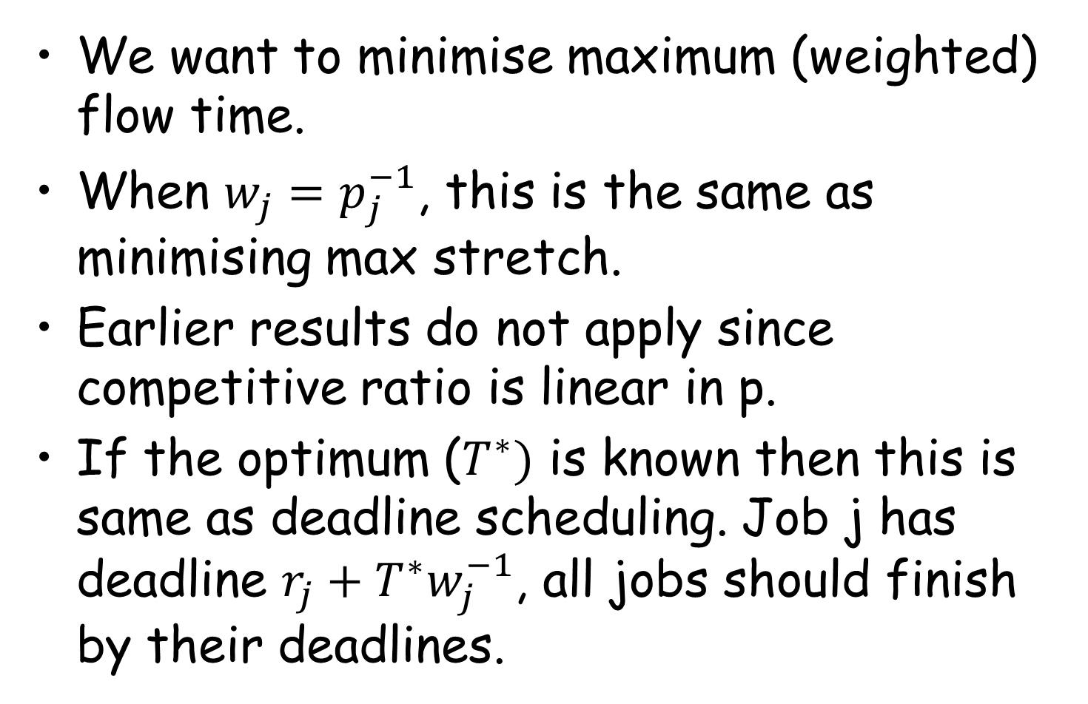

What when $p=∞$?
We want to minimise maximum (weighted) flow time.
When $w_{j}=p_{j}^{−1}$, this is the same as minimising max stretch.
Earlier results do not apply since competitive ratio is linear in p.
If the optimum ($T^{∗})$ is known then this is same as deadline scheduling. Job j has deadline $r_{j}+T^{∗}w_{j}^{−1}$, all jobs should finish by their deadlines.

Slide 52
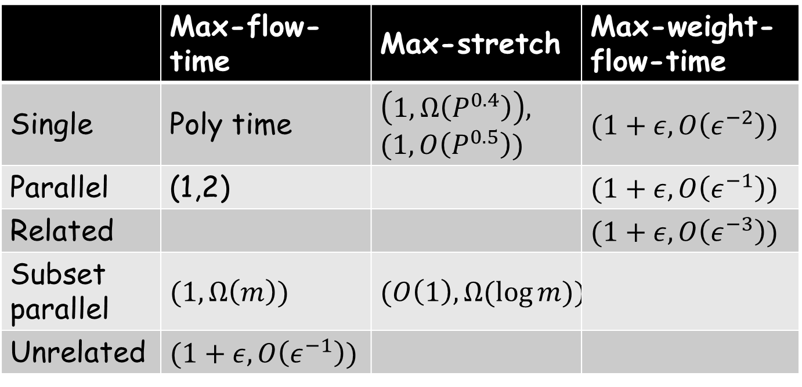
The current status
 | Max-flow-time | Max-stretch | Max-weight-flow-time
Single | Poly time | $$\left(1,Ω\left(P^{0.4}\right)\right),$$ $$(1, O\left(P^{0.5}\right))$$ | $$(1+ε,O\left(ε^{−2}\right))$$
Parallel | (1,2) |  | $$(1+ε,O\left(ε^{−1}\right))$$
Related |  |  | $$(1+ε,O\left(ε^{−3}\right))$$
Subset parallel | $$(1,Ω\left(m\right))$$ | $$(O\left(1\right),Ω(\log{m))}$$
Unrelated | $$(1+ε,O\left(ε^{−1}\right))$$
(a,b): b-competitive algorithm with a-speed machines.

Slide 53
Immediate vs. non-immediate
Insisting on immediate dispatch will quickly get you into trouble.
A simple example (load balancing lower bound of Azar et.al.’95)
Subset parallel setting
Unit length and weight jobs
No constant competitive algorithm with constant speed-up.
Hence all results assume non-immediate dispatch.

Slide 54
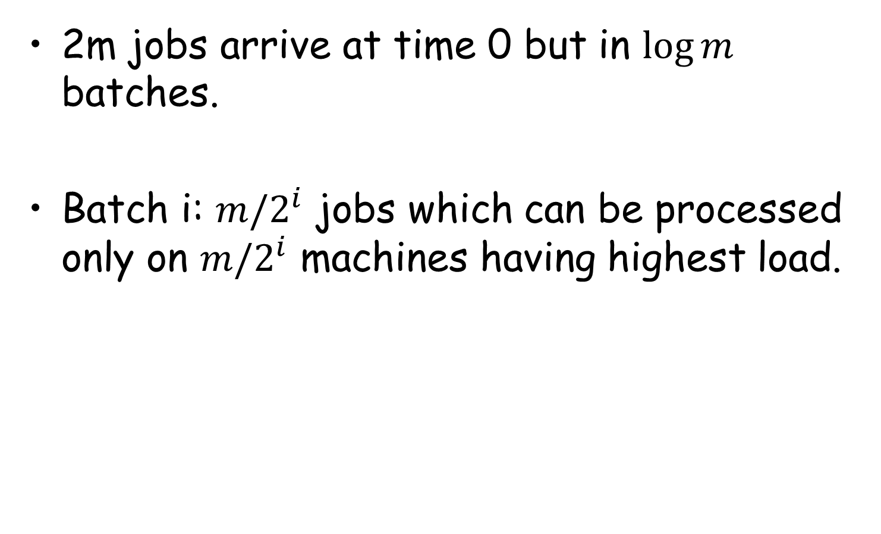
Bad example for imm. dispatch
2m jobs arrive at time 0 but in $\log{m}$ batches.
Batch i: $m/2^{i}$ jobs which can be processed only on $m/2^{i}$ machines having highest load.

Slide 55
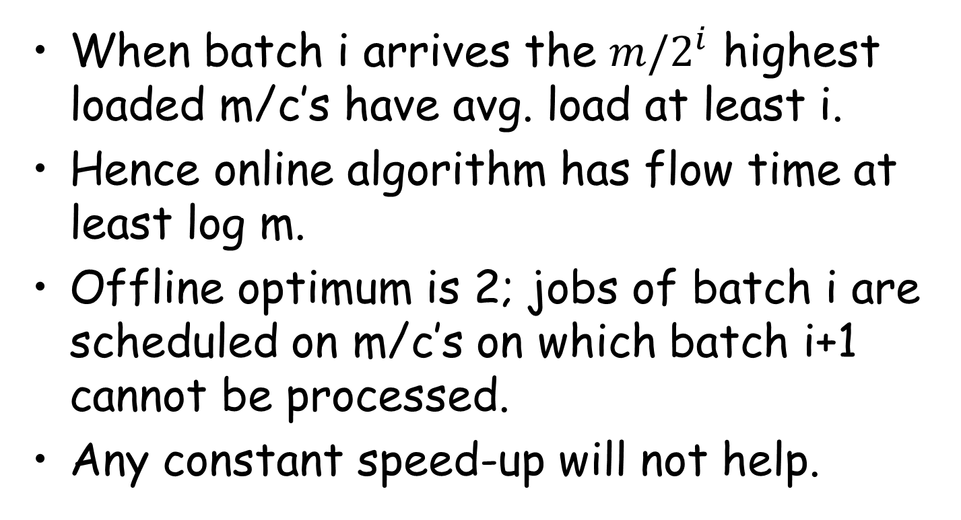
Bad example (contd.)
When batch i arrives the $m/2^{i}$ highest loaded m/c’s have avg. load at least i.
Hence online algorithm has flow time at least log m.
Offline optimum is 2; jobs of batch i are scheduled on m/c’s on which batch i+1 cannot be processed.
Any constant speed-up will not help.

Slide 56
The rejection model
Speed augmentation does not help if
We want immediate dispatch and minimise max flow time.
Minimise max stretch in subset parallel model.
Online algorithm allowed to reject ε-fraction of the jobs/total weight.
Jobs once rejected cannot be revoked.
We want non-migratory, immediate-dispatch algorithms; pre-emption allowed.

Slide 57
Rejection model (contd.)
Natural assumption in many settings
Terms in Service Level Agreements.
“Server busy: Please try again later” message when accessing popular websites
Intuitively stronger than speed augmentation model
Simulate by rejecting every (1/ε)th job on each machine
Overall rejection over all machines (and not on every machine) is ε-fraction

Slide 58
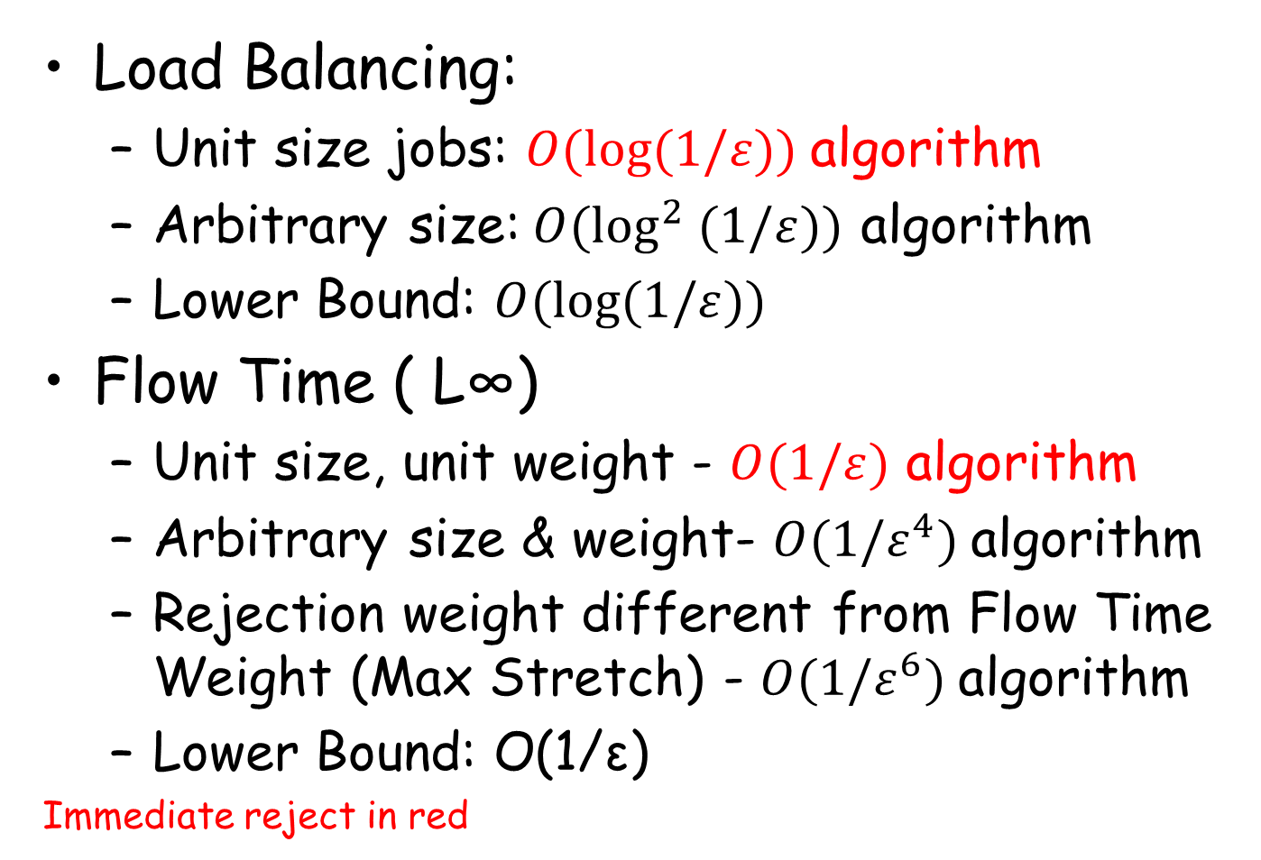
Our results (CDGK ‘15)
Load Balancing:
Unit size jobs: $O(log⁡(1/ε))$algorithm
Arbitrary size:$O(\log^{2} (1/ε))$ algorithm
Lower Bound: $O(log⁡(1/ε))$
Flow Time ( L∞)
Unit size, unit weight - $O(1/ε)$ algorithm
Arbitrary size & weight- $O(1/ε^{4})$algorithm
Rejection weight different from Flow Time Weight (Max Stretch) - $O(1/ε^{6})$algorithm
Lower Bound: O(1/ε)
Immediate reject in red

Slide 59
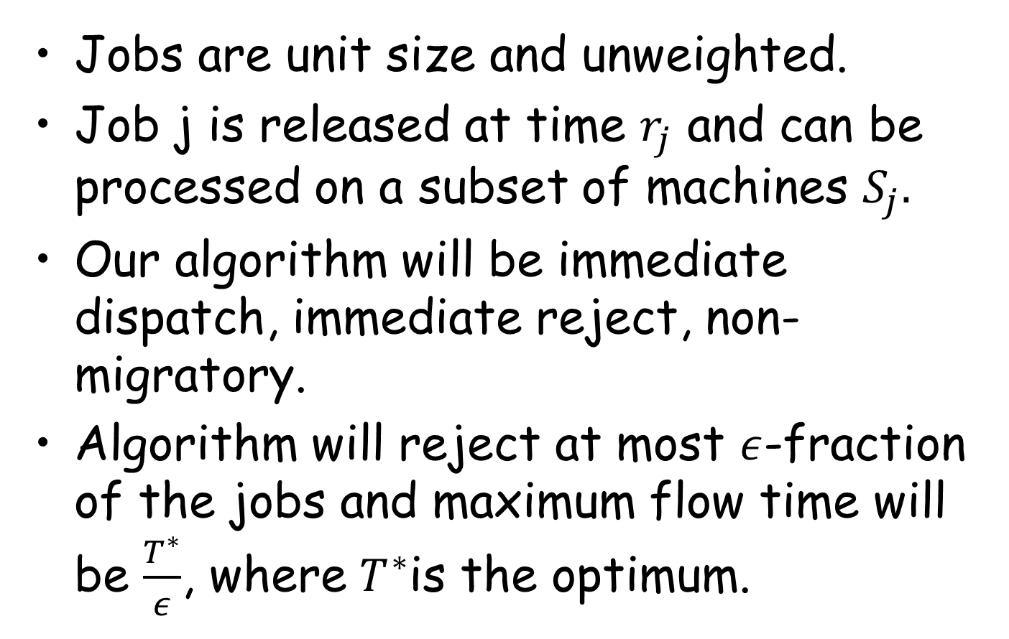
This talk: max flow time
Jobs are unit size and unweighted.
Job j is released at time $r_{j}$ and can be processed on a subset of machines $S_{j}.$
Our algorithm will be immediate dispatch, immediate reject, non-migratory.
Algorithm will reject at most $ε$-fraction of the jobs and maximum flow time will be $\frac{T^{∗}}{ε}$, where $T^{∗}$is the optimum.

Slide 60
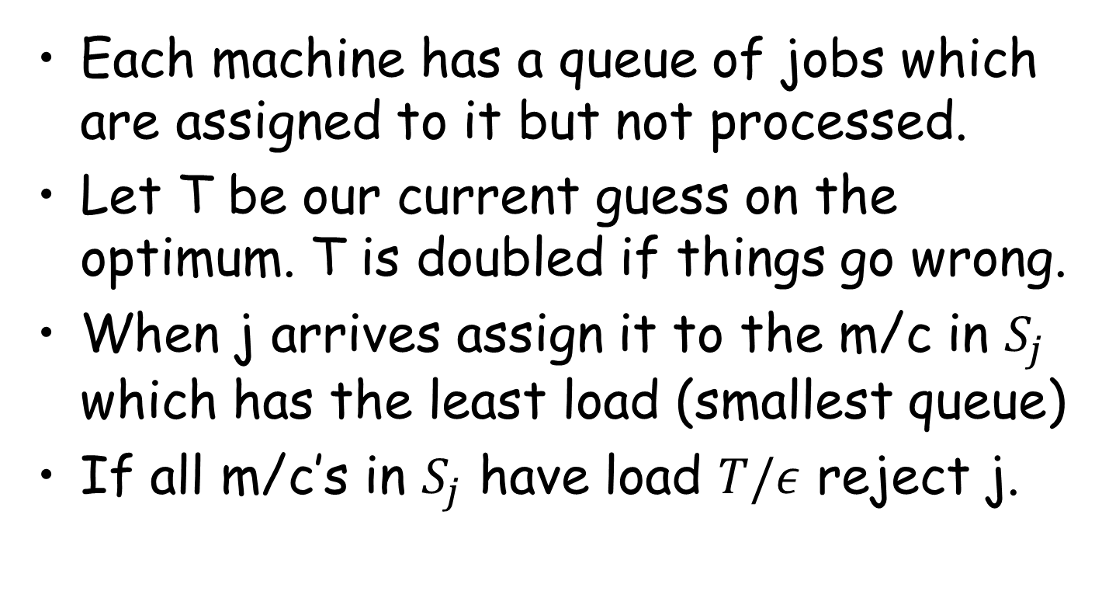
The algorithm: GREEDY
Each machine has a queue of jobs which are assigned to it but not processed.
Let T be our current guess on the optimum. T is doubled if things go wrong.
When j arrives assign it to the m/c in $S_{j}$ which has the least load (smallest queue)
If all m/c’s in $S_{j}$ have load $T/ε$ reject j.

Slide 61
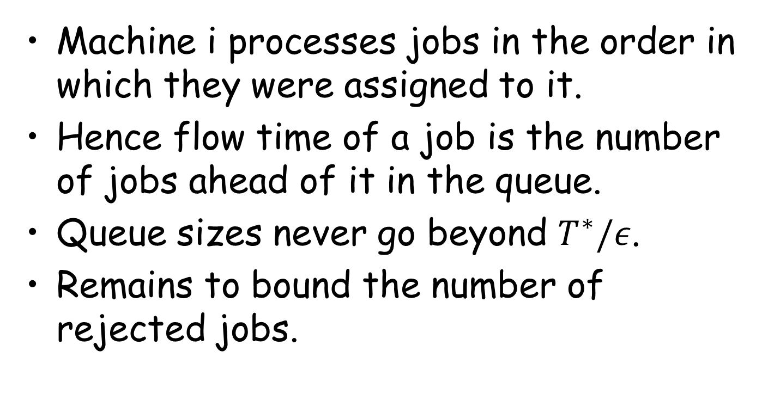
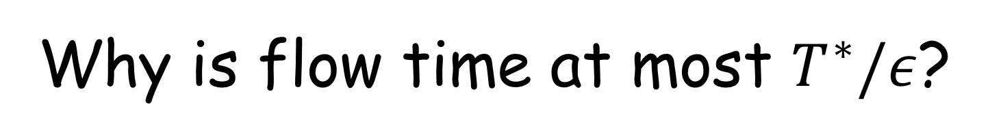
Why is flow time at most $T^{∗}/ε$?
Machine i processes jobs in the order in which they were assigned to it.
Hence flow time of a job is the number of jobs ahead of it in the queue.
Queue sizes never go beyond $T^{∗}/ε$.
Remains to bound the number of rejected jobs.

Slide 62

MaxFlowTime Algorithm (Illustration)
t=1
2
3
T*/ε = 2

Slide 63
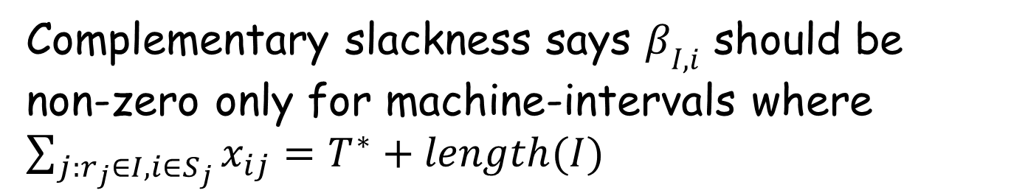
Primal and Dual LPs
Complementary slackness says $β_{I,i}$ should be
non-zero only for machine-intervals where $\sum_{j:r_{j}∈I, i∈S_{j}}{x_{ij}=T^{∗}+length(I)}$

Slide 64
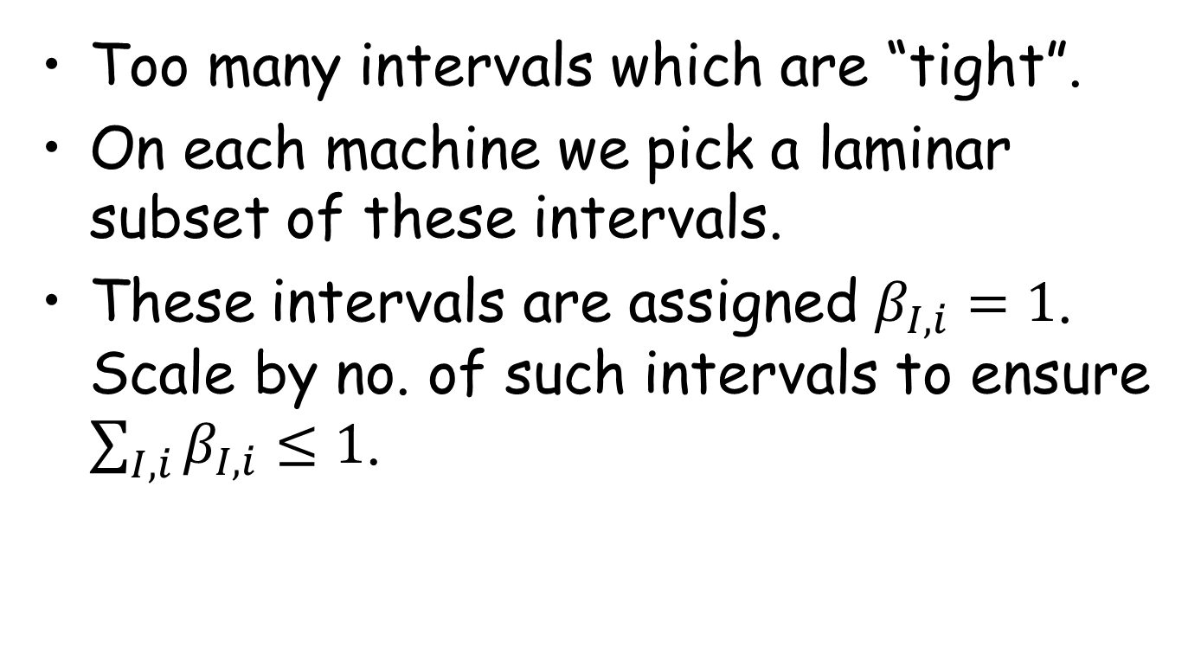

How to set $β_{I,i}$
Too many intervals which are “tight”.
On each machine we pick a laminar subset of these intervals.
These intervals are assigned $β_{I,i}=1$. Scale by no. of such intervals to ensure $\sum_{I,i}{β_{I,i}≤1}$.

Slide 65
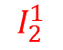
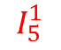
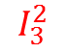
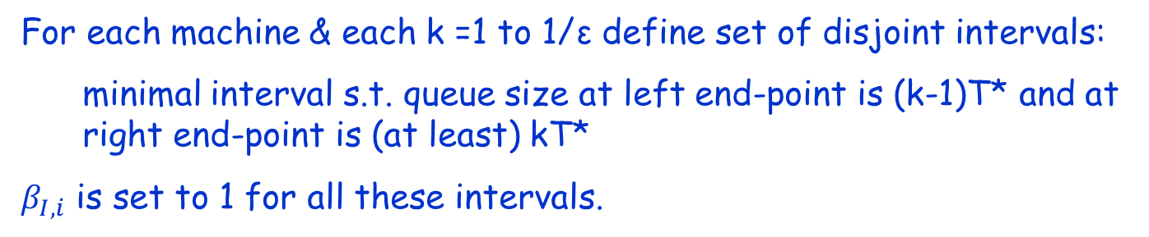
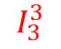
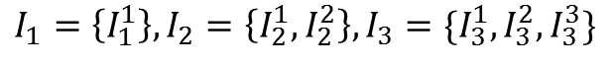
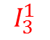
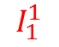
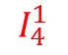
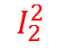
Machine Intervals
Queue
Size on m/c i
5T*
4T*
$$I_{5}^{1}$$
k=5
3T*
$$I_{4}^{1}$$
k=4
2T*
$$I_{3}^{1}$$
$$I_{3}^{2}$$
$$I_{3}^{3}$$
k=3
T*
$$I_{2}^{1}$$
$$I_{2}^{2}$$
k=2
$$I_{1}^{1}$$
k=1
$${I_{1}=\left\{I_{1}^{1}\right\}, I_{2}=\left\{I_{2}^{1},I_{2}^{2}\right\}, I}_{3}=\{I_{3}^{1},I_{3}^{2},I_{3}^{3}\}$$
For each machine & each k =1 to 1/ε define set of disjoint intervals:
minimal interval s.t. queue size at left end-point is (k-1)T* and at right end-point is (at least) kT*
$β_{I,i}$ is set to 1 for all these intervals.

Slide 66
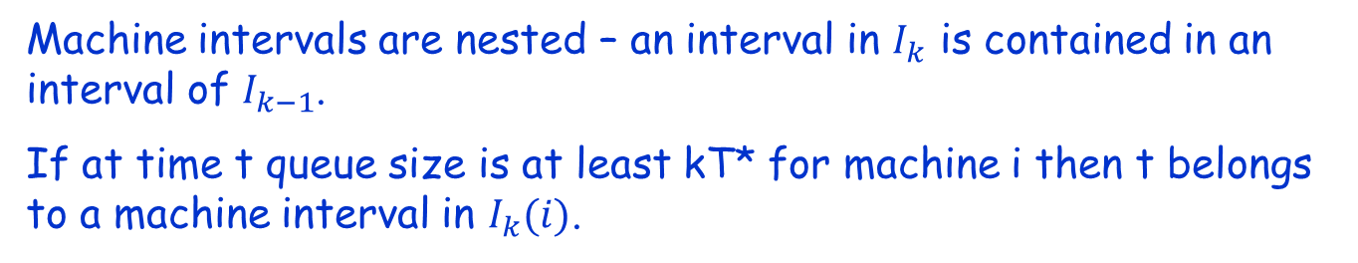
Machine Intervals
Queue
Size on m/c i
5T*
4T*
$$I_{5}^{1}$$
3T*
$$I_{4}^{1}$$
2T*
$$I_{3}^{1}$$
$$I_{3}^{2}$$
$$I_{3}^{3}$$
T*
$$I_{2}^{1}$$
$$I_{2}^{2}$$
$$I_{1}^{1}$$
$${I_{1}=\left\{I_{1}^{1}\right\}, I_{2}=\left\{I_{2}^{1},I_{2}^{2}\right\}, I}_{3}=\{I_{3}^{1},I_{3}^{2},I_{3}^{3}\}$$
Machine intervals are nested – an interval in $I_{k}$ is contained in an interval of $I_{k−1}$.
If at time t queue size is at least kT* for machine i then t belongs to a machine interval in $I_{k}(i)$.

Slide 67
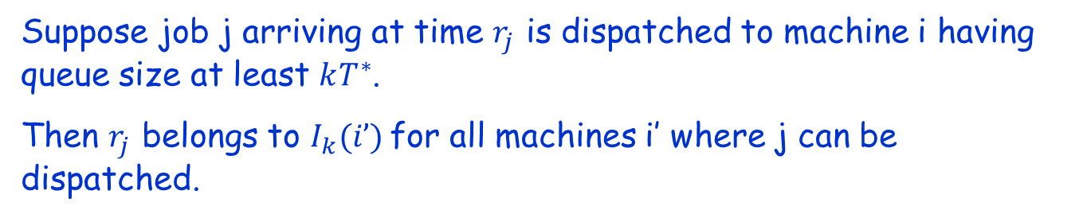
Machine Intervals
Queue
Size on m/c i
5T*
4T*
$$I_{5}^{1}$$
3T*
$$I_{4}^{1}$$
2T*
$$I_{3}^{1}$$
$$I_{3}^{2}$$
$$I_{3}^{3}$$
T*
$$I_{2}^{1}$$
$$I_{2}^{2}$$
$$I_{1}^{1}$$
$${I_{1}=\left\{I_{1}^{1}\right\}, I_{2}=\left\{I_{2}^{1},I_{2}^{2}\right\}, I}_{3}=\{I_{3}^{1},I_{3}^{2},I_{3}^{3}\}$$
Suppose job j arriving at time $r_{j}$ is dispatched to machine i having queue size at least $kT^{∗}$.
Then $r_{j}$ belongs to $I_{k}(i’)$for all machines i’ where j can be dispatched.

Slide 68
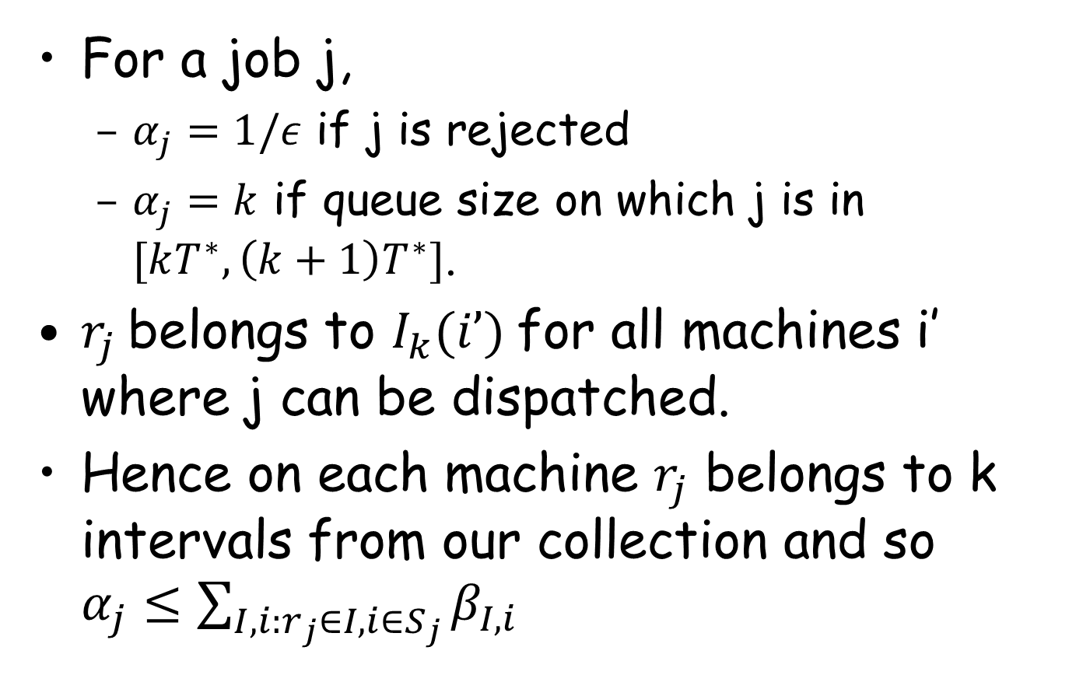

Choosing feasible $α_{j}$
For a job j,
$α_{j}=1/ε$ if j is rejected
$α_{j}=k$ if queue size on which j is in $[kT^{∗},\left(k+1\right)T^{∗}]$.
$r_{j}$belongs to $I_{k}(i’)$for all machines i’ where j can be dispatched.
Hence on each machine $r_{j}$ belongs to k intervals from our collection and so $α_{j}≤\sum_{I,i:r_{j}∈I, i∈S_{j}}{β_{I,i}}$

Slide 69
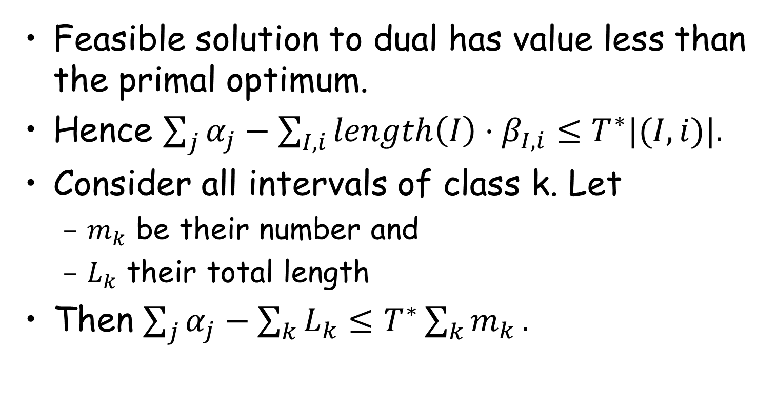
By Weak duality
Feasible solution to dual has value less than the primal optimum.
Hence $\sum_{j}{α_{j}}−\sum_{I,i}{length\left(I\right){⋅β}_{I,i}}≤T^{∗}|(I,i)|.$
Consider all intervals of class k. Let
$m_{k}$ be their number and
$L_{k}$ their total length
Then $\sum_{j}{α_{j}}−\sum_{k}{L_{k}}≤T^{∗}\sum_{k}{m_{k}}.$

Slide 70
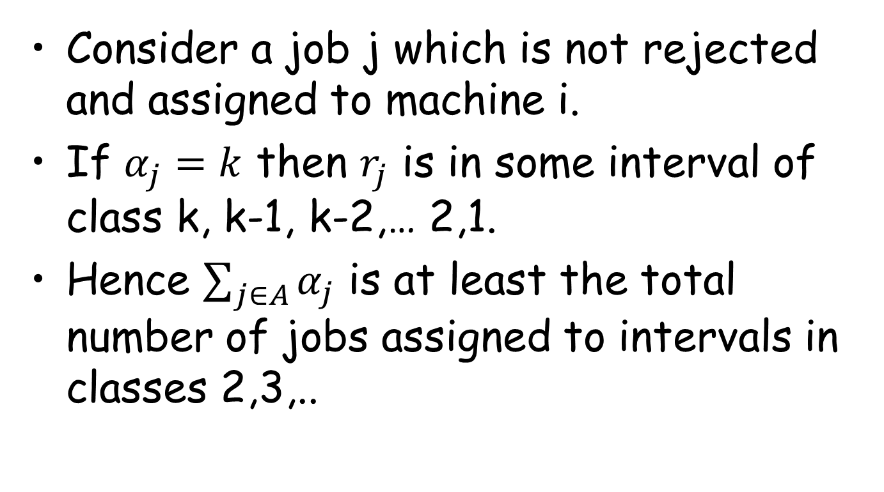
The Analysis
Consider a job j which is not rejected and assigned to machine i.
If $α_{j}=k$ then $r_{j}$ is in some interval of class k, k-1, k-2,… 2,1.
Hence $\sum_{j∈A}{α_{j}}$ is at least the total number of jobs assigned to intervals in classes 2,3,..

Slide 71
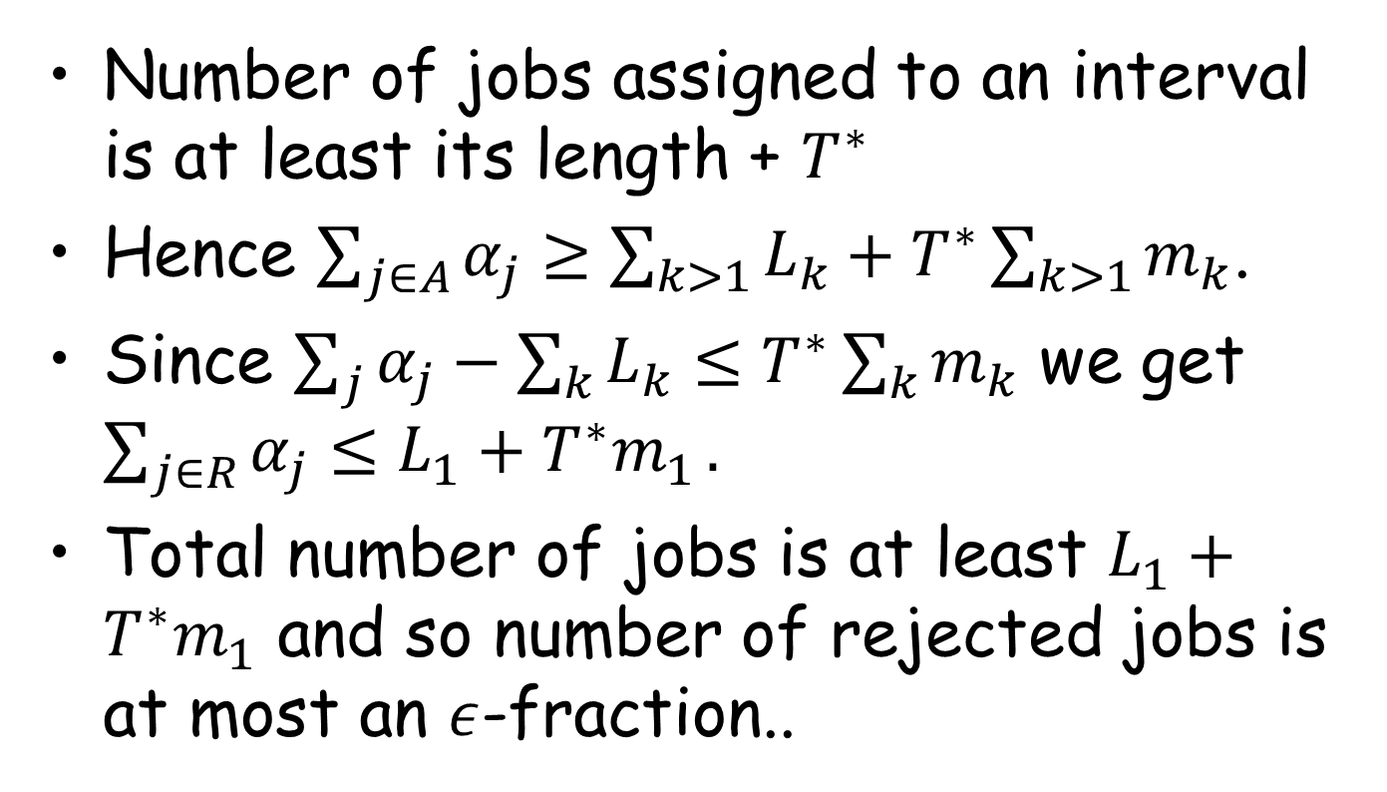
The analysis (contd)
Number of jobs assigned to an interval is at least its length + $T^{∗}$
Hence $\sum_{j∈A}{α_{j}}≥\sum_{k>1}{L_{k}+T^{∗}\sum_{k>1}{m_{k}}}$.
Since $\sum_{j}{α_{j}}−\sum_{k}{L_{k}}≤T^{∗}\sum_{k}{m_{k}}$ we get $\sum_{j∈R}{α_{j}≤L_{1}+T^{∗}m_{1}}.$
Total number of jobs is at least $L_{1}+T^{∗}m_{1}$ and so number of rejected jobs is at most an $ε$-fraction..

Slide 72
Summary
Dual fitting is a powerful technique for analysing, both offline and online, algorithms.
In this talk I showed how dual fitting can work with faster machines and job rejection.

Slide 73
Thank you for your attention

